Slide 1


Practical Cloud Development With Azure

Slide 2




Lars Klint
@larsklint
Notes:
Ask people to introduce themselves
Name
Experience

Slide 3



Azure Timeline
The highlights.
Project Red Dog
Commercially Available
Portal
This was the code name for Azure when in development.
21 countries could use Windows Azure from February.
First web based portal interface.
2008
2010
2012

Slide 4



More highlights.
Rename and new Portal
Logo and Manifesto
Growth
In April Windows Azure became Microsoft Azure.
New portal for ARM.
New logo and new manifesto for the Azure mission.
Global market share of 13% and fastest growing cloud platform.
2014
2017
2018

Slide 5
https://www.gartner.com/en/newsroom/press-releases/2018-09-12-gartner-forecasts-worldwide-public-cloud-revenue-to-grow-17-percent-in-2019

Slide 6
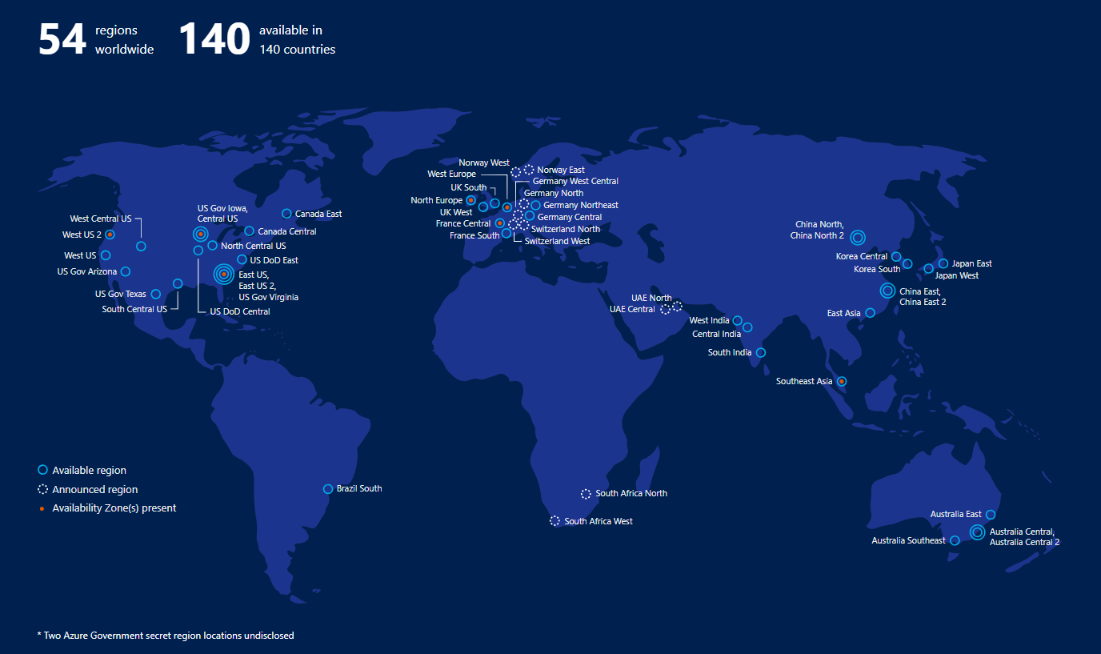
Azure Regions

Slide 7

Azure Boundaries
1
Region
A set of data centres deployed within a latency-defined perimeter and connected through a dedicated regional low-latency network.
2
Geography
A discrete market, typically containing two or more regions.
3
Availability Zone
Physically separate locations within an Azure region. One or more data centres in each.

Slide 8
Choosing Regions
Compliance
Availability
Pricing

Slide 9
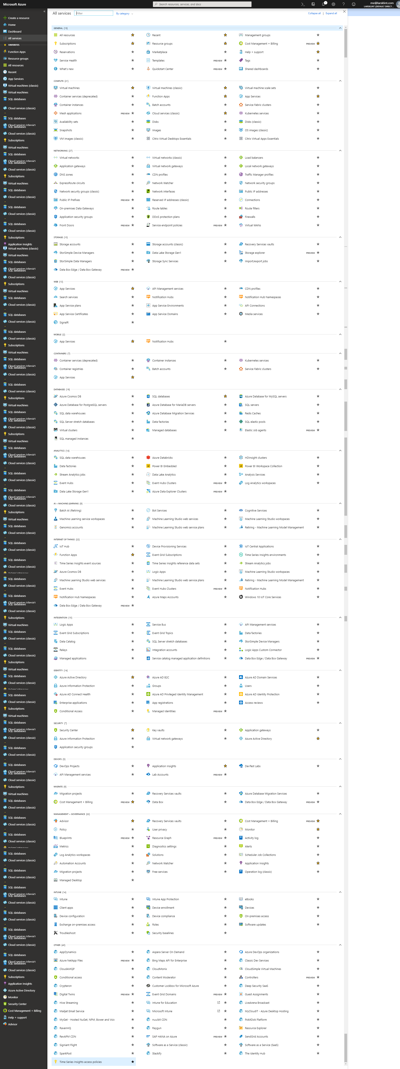
Azure Services

Slide 10
Azure Building Blocks
Management
Security
Intelligence
Data
Hybrid Cloud
Integration
Media & CDN
Application
Compute Services
Developer Services
Analytics & IoT
Compute
Storage
Networking

Slide 11
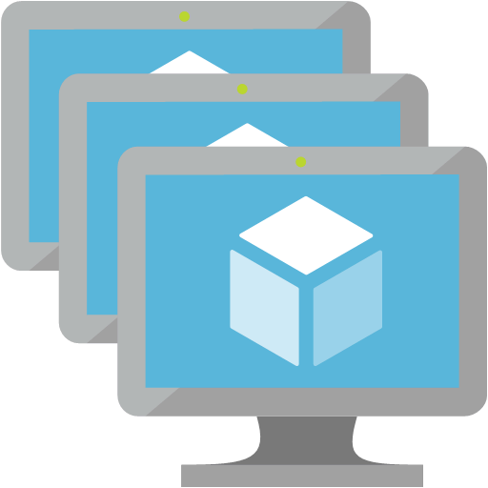


Cloud Services
IaaS
PaaS
Serverless
Servers/VMs
Networks
Data center off-prem
Control over services
No servers
Web Apps
Cosmos DB
Azure SQL
Consumption
Scalability
“Infinite” compute
Functions
Notes:
Explain IaaS, PaaS, serverless

Slide 12
Demo
Azure Portal

Slide 13
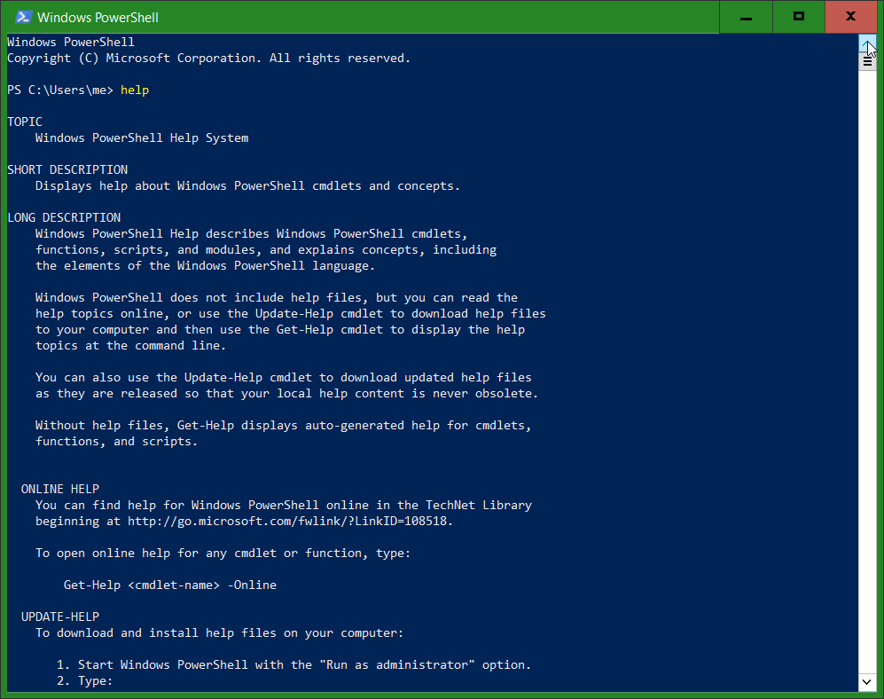
Notes:
Powershell

Slide 14
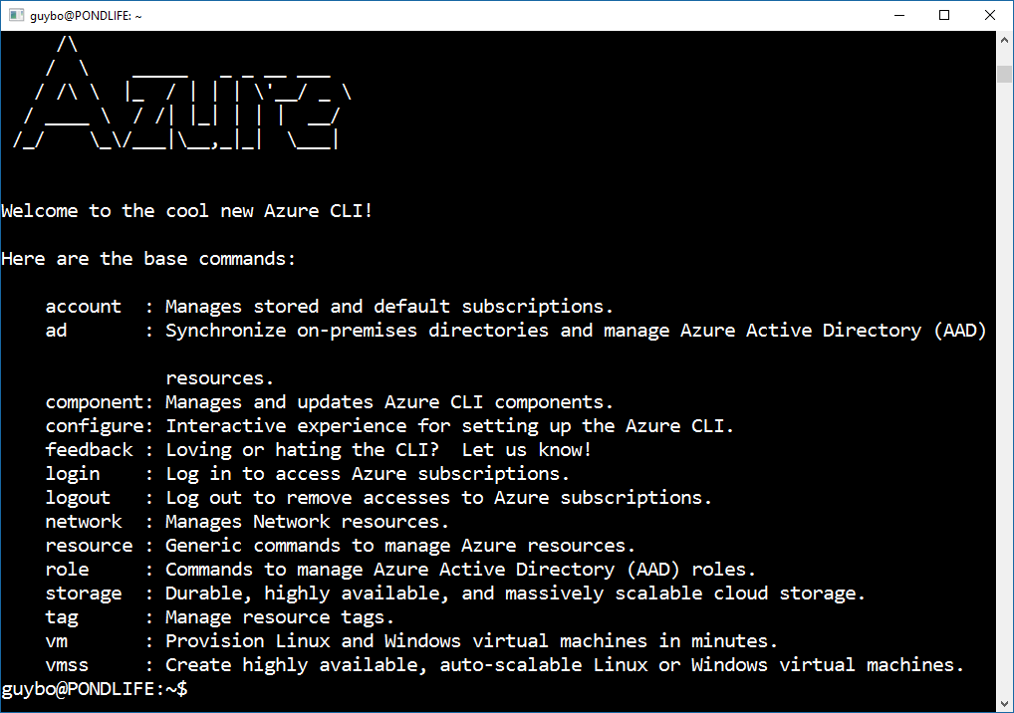
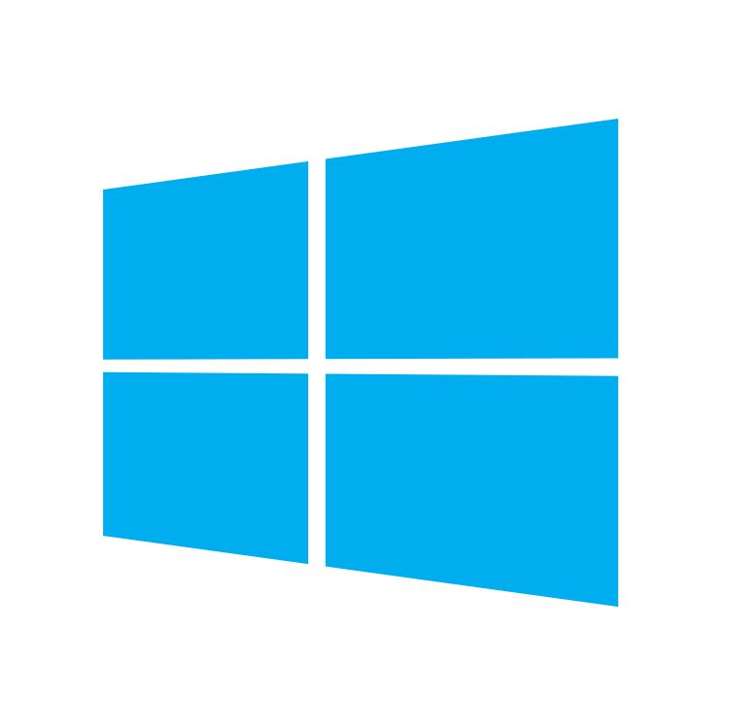



Notes:
Azure CLI

Slide 15
Practical Cloud Development With Azure
Notes:
Workshop overview

Slide 16
Day 1
9:00 | Introduction to Azure
10:00 | Break
10:15 | Tooling and Installation
11:00 | Break
11:15 | Azure Basics
12:15 | Lunch
13:15 | App Services
14:45 | Break
15:00 | Azure DevOps
16:00 | Q&A - Catchtup
Notes:
Agenda for workshop

Slide 17
Day 2
9:00 | Summary of Day 1
9:15 | Data
10:15 | Break
10:30 | Serverless Part 1
12:00 | Lunch
13:00 | Serverless Part 2
14:00 | Security
15:00 | Break
15:15 | AI & ML
16:15 | Wrap up
Notes:
Agenda for workshop

Slide 18



Workshop
Theory/Practice
Project
Information
Overload
Notes:
Structure
Lessons are part theory, part practice
Project being used where possible
Lots of information, and some won’t be in depth.

Slide 19
https://github.com/lklint/azure-workshop/
Notes:
Please don’t skip ahead, as you will lose context and not be able to benefit from the discussion.

Slide 20
Notes:
Assign discount codes and give out t-shirts

Slide 21


Notes:
I can’t know everything. Azure is massive. It is a 2-day collaboration where I provide the guidance and structure.

